Slide 1
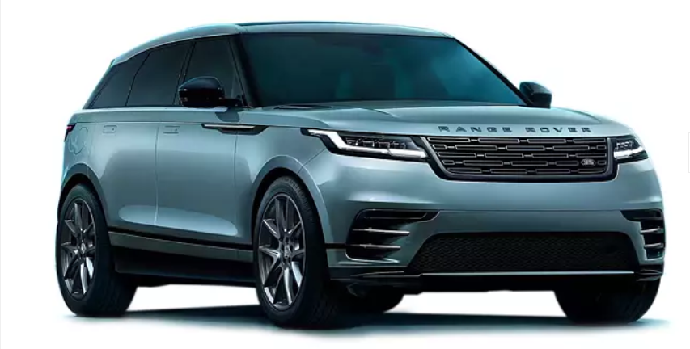

JLR HACKATHON
Future Parts Cost Predictor
Heavy Drivers
28 June 2024
Confidential ©2024

Slide 2
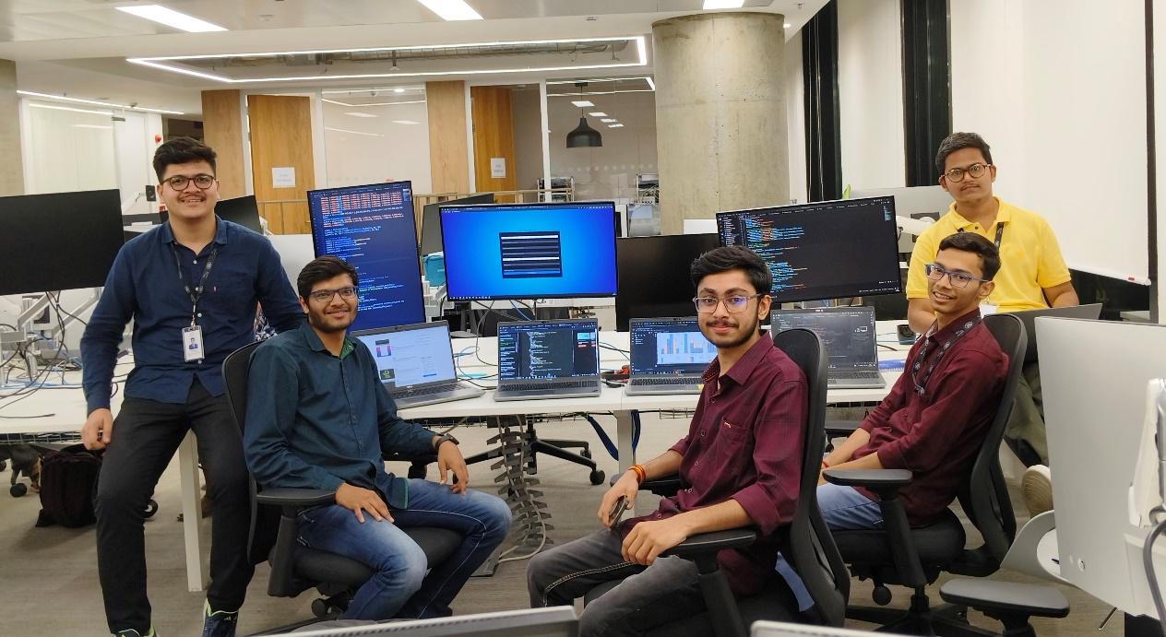



Introducing the team HEAVY DRIVERS
Manaswi Raj, Harshit Gupta, Lakshya Vaishya, Aditya Khariwal, P Hemanth Naidu
(Left to right)

Slide 3
Plan
Problem statement
Detailed cost analysis takes time
Need a way to accurately predict the cost of parts in order to ascertain whether the vehicle would be profitable.
Objectives
Implement a solution to predict future supplier costs
Maintain an acceptable level of accuracy
Suggest which variables hold a stronger predictor power for cost

Slide 4
Solution
We used GANs to generate more data from small dataset.
A feed-forward neural network predicted cost from eight attributes.
Country of production was encoded to integers for input to neural network
Implementation
We used CTGAN library for data generation with GANs.
TensorFlow was used for the feed-forward neural network.
We built a website using Flask where we can give the attribute values to predict cost

Slide 5
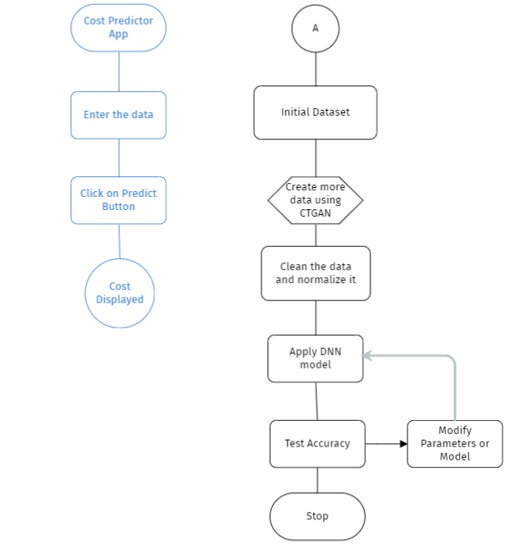
Flowchart

Slide 6
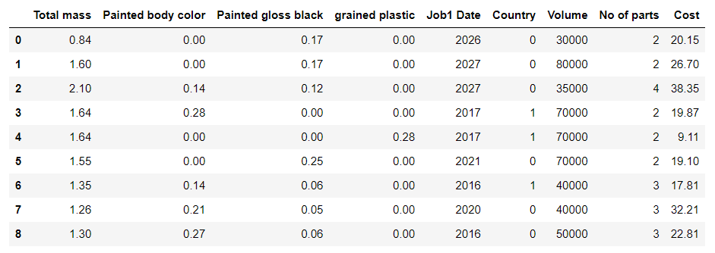
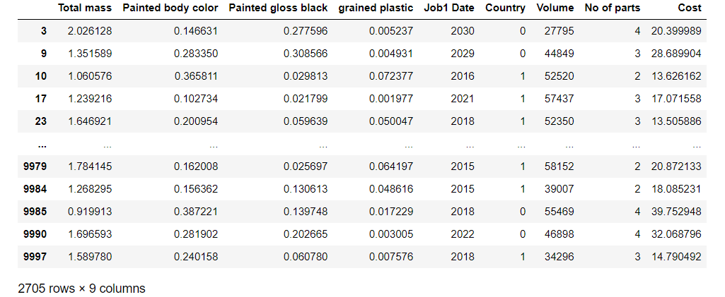
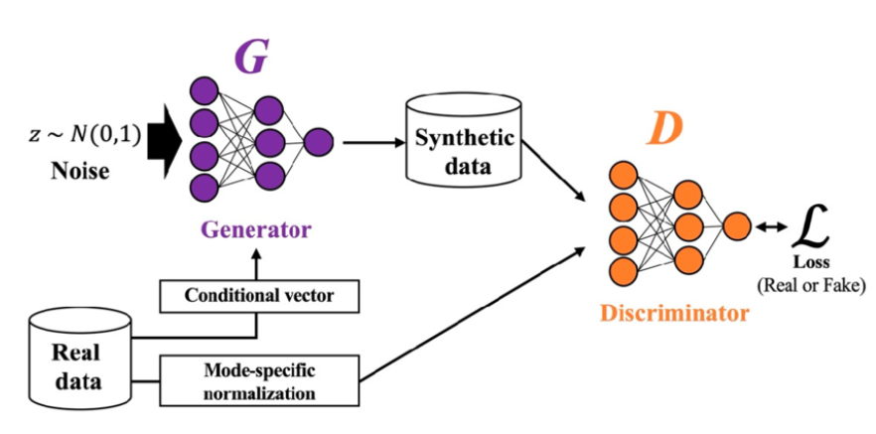
Using Conditional Tabular GAN (CTGAN) for preparing the dataset
Initial Dataset
Initially Dataset had only 9 entries.
We need more entries for applying neural networks.
Used CTGAN, to create more data, based on given dataset
Clean the dataset
Updated Dataset had 2705 valid entries
Updated Dataset

Slide 7
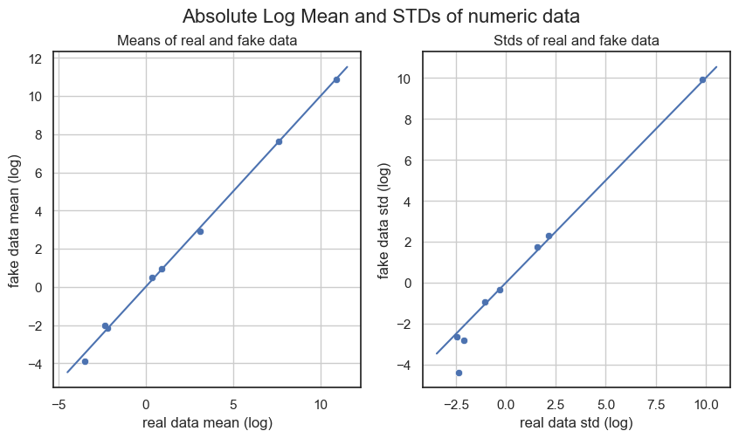

Slide 8
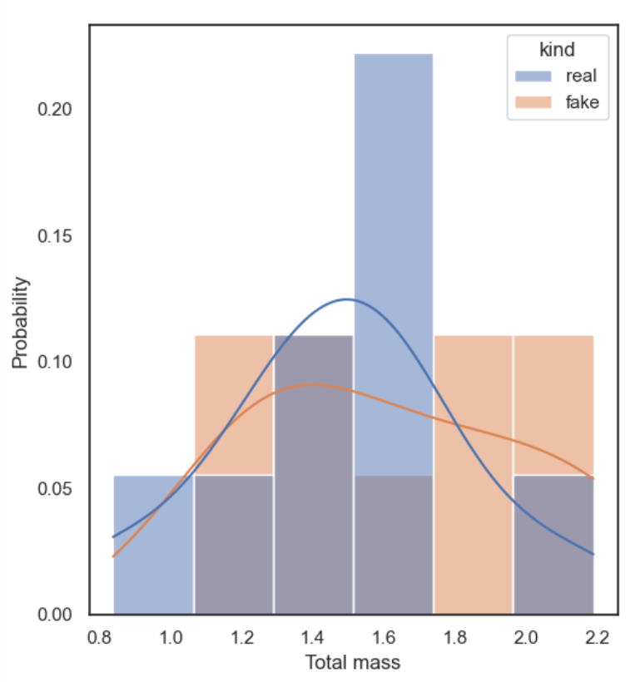
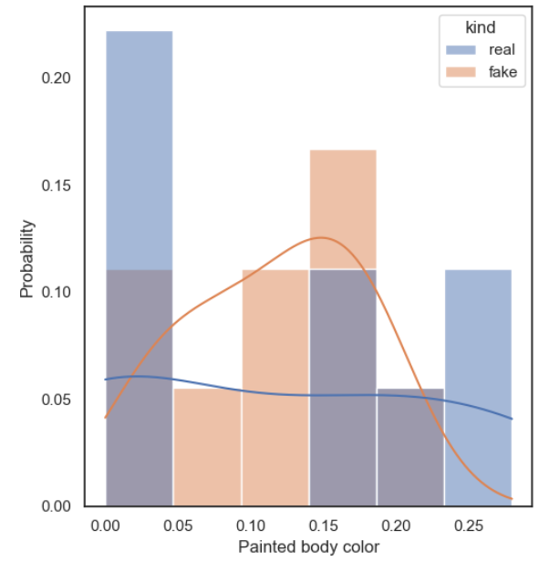
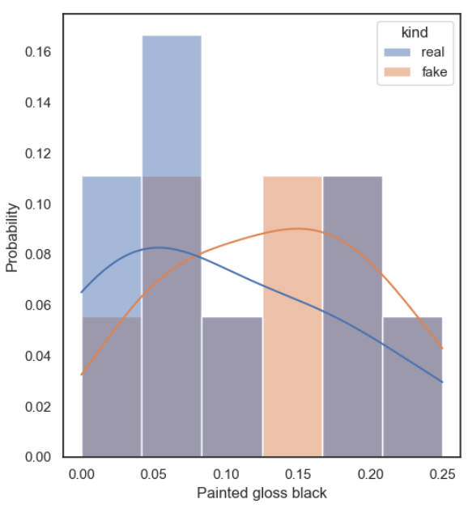
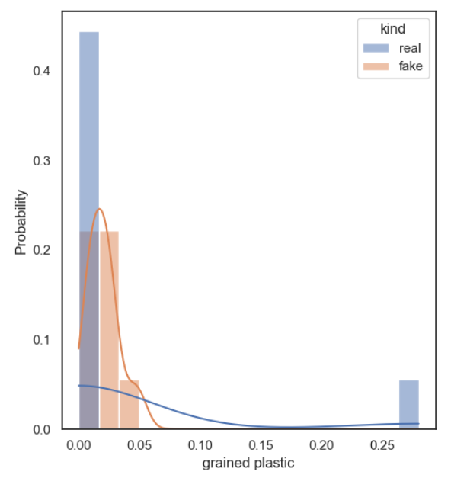
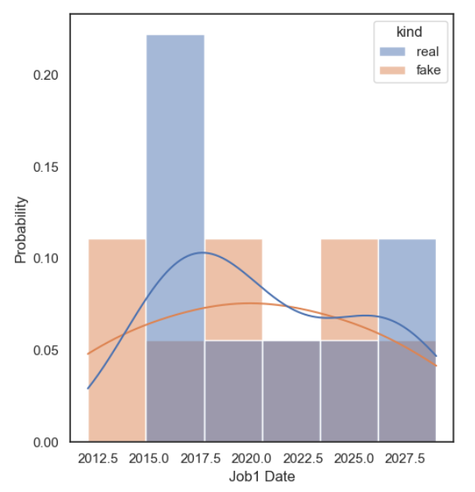
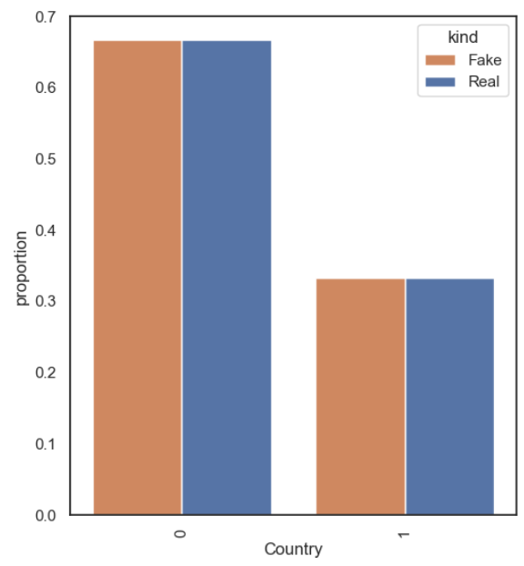
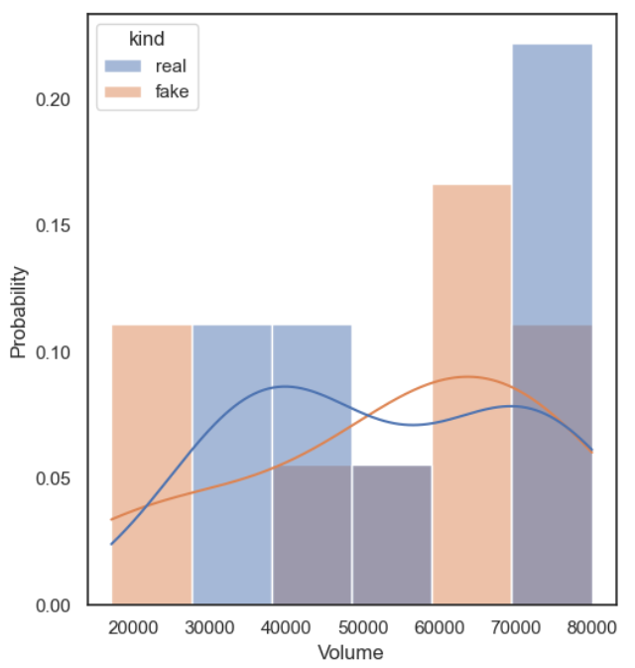
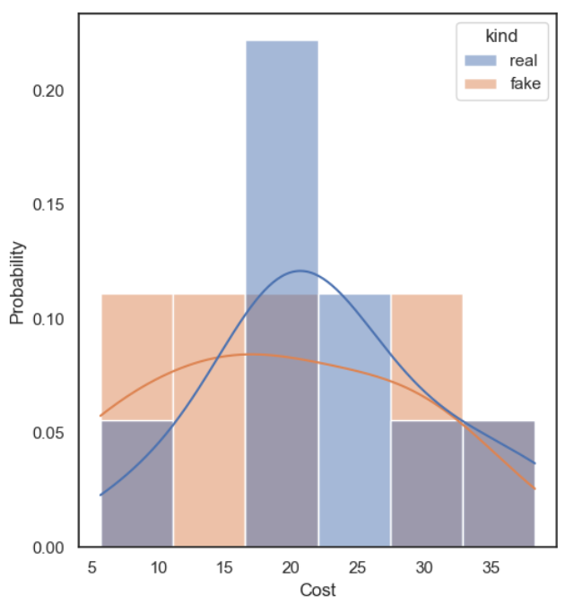
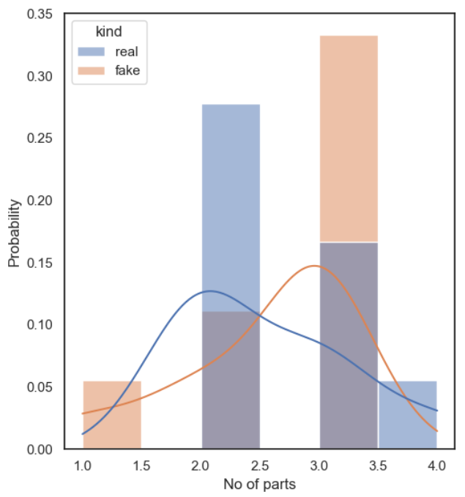
Distribution per feature

Slide 9
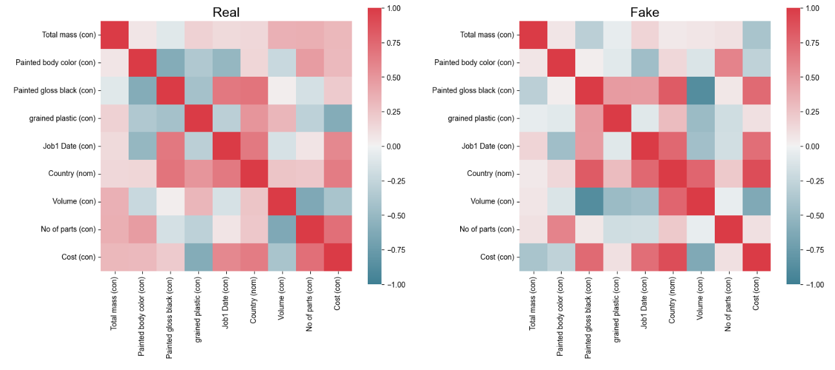
The following correlation diagram shows noticeable correlations between the variables.
Maximum correlation of cost is with No. of Parts
Minimum correlation of cost is with Total Mass

Slide 10
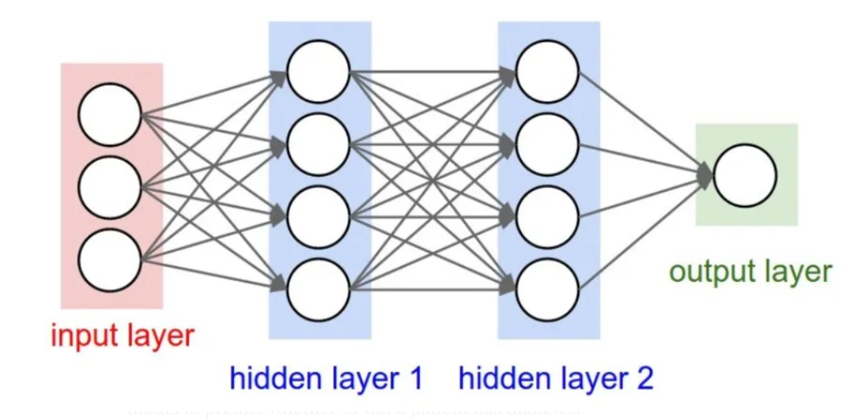
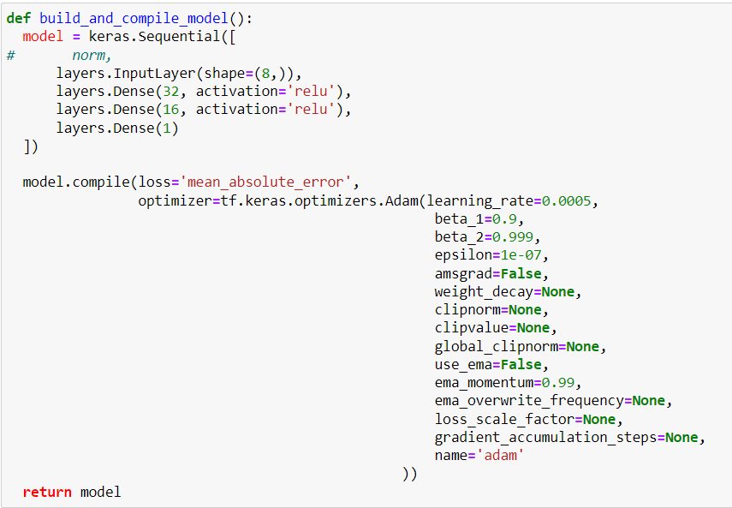
Using neural network to train the dataset

Slide 11
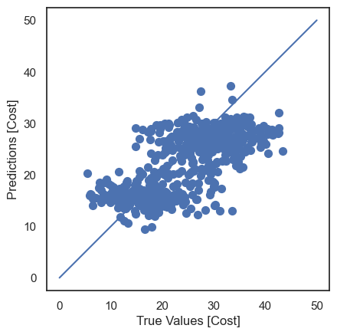
Results
Mean Absolute Error = 0.138

Slide 12
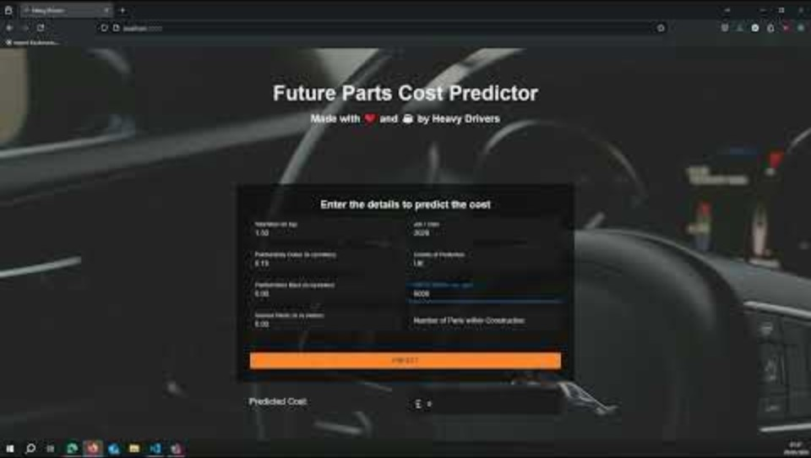
Video Demo
https://youtu.be/NF6tDX8d7K4

Slide 13
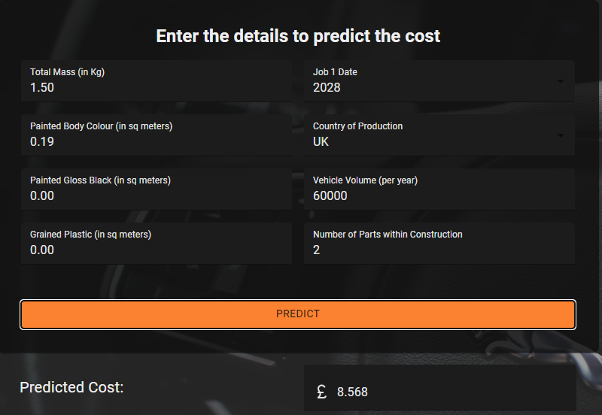
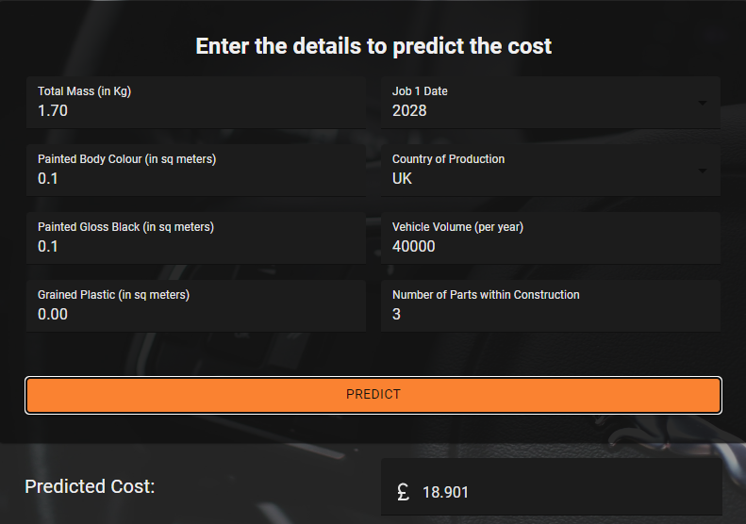
Predictions

Slide 14
Conclusion
Analysed the data & provided a rationale for the relationship between certain variables and part cost.
No. of Parts hold a stronger predictor power for cost
Created a model which predict cost using key features of the part, and the
manufacturing scenario.
Extended that model to also work when only certain features are available, and the rest are missing.
Made a website which takes the required input and predict the cost.
Margin of error is less than 5 pounds.

Slide 15








THANK YOU
Aditya Khariwal (akhariwa)
Software Intern
akhariwa@partner.jaguarlandrover.com
Manaswi Raj (mraj6)
Software Engineer
mraj6@partner.jaguarlandrover.com
Harshit Gupta (hgupta5)
Software Intern
hgupta5@partner.jaguarlandrover.com
Lakshya Vaishya (lvaishya)
Software Intern
lvaishya@partner.jaguarlandrover.com
P Hemanth Naidu (pnaidu2)
Software Intern
pnaidu2@partner.jaguarlandrover.com
Jaguar Land Rover
BEE Building, Brigade Tech Gardens, Tigalarpalya, Brookefield, Bengaluru, Karnataka 560066
jaguarlandrover.com

